Slide 1

HARARE REGION - IT
Our Vision
To be the major driving force behind business growth and success through the innovative use of Information and Communication Technology (ICT).
Our Mission
To enhance customer experience and competitiveness through sustainable and innovative use of ICT.
30 April 2024

Slide 2
STAFF COMPLIMENT & KRAs
8 Permanent
1 Vacant
4 contract (Programmers & SSOs)
^{No.} | ^{Key Result Area} | ^{Weightage}
KRA1 | Provide reliable ICT services | 30%
KRA2 | Improve business productivity and operational efficiency | 70%

Slide 3
ACTIVITY/PROJECT | 1st Quarter Targets | Actual | Variance | CHALLENGES | MITIGATION MEASURES | 2024 Targets
Business processes automated and reviewed |  |  |  | Hardware and services procurement challenges Staff turnover Competing demands/projects. Commitment from user departments Changing user requirements Integration challenges with existing systems. Hardware for security on internet facing end. Data acquisition. Lack of expertise. Compatibility of application with all devices. Commitment from consultants. | Adopt innovative ways to address procurement challenges. Review IT Org Chart Collaborate with HO and other regions to boost programming team. Organisational change management Train staff.
Invoice checking | 50% | 25% | 25% | Staff turnover | Review IT Org Chart | 100%
IRBM Appraisal system | 0% | 0% | - | Competing demands. | Collaborate with HO and other regions to boost programming team. | 100%
BE Dashboards | 100% | 50%% | 50% | Commitment from user departments Changing user requirements Integration challenges with existing systems. | Organisational change management | 100%
HR Asset register | 100% | 90% | 10% | Commitment from user department. | Organisational change management. | 100%
Network Equipment Inspection | 0% | 0% | - | Hardware for security on internet facing end. Competing projects. | Firewall acquisition | 100%
ID cards login | 0% | 0% | - | Data acquisition. Lack of expertise. | Capture as per request Train staff. | 100%
New Connection Records | 100% | 90% | 10% | Commitment from user department. | Organisational change management. | 100%
Safety Documents | 60% | 60% | 0% | Hardware for security on internet facing end. |  | 100%
ND Quotations | 100% | 100% | 0% |  |  | 100%
Loadshedding App | 90% | 90% | 0% |  |  | 100%

Slide 4
ACTIVITY/PROJECT | 1st Quarter Target | Actual | Varience | CHALLENGES | MITIGATION MEASURES | 2024 Targets
Hardware Acquired and Upgraded To replace: 263 computers 2 Routers 10 Switches | 25% | 5.14% 14 PCs (11 Desktops, 5 Laptops) 1 Switch | 93.75% | Challenges with procurement (Powertel failing to deliver). Theft ( 1 laptop lost in 2024) Undelivered orders -105 PCs (42 laptops + 63 Laptops). Switches being procured centrally from HO. | Persue DOM 12 of 2023 tender with 74 laptop and 126 desktop PCs. To procure critical PCs from alternative suppliers. BYOD currently being used as a stopgap measure Considering GPS tracking for laptops Considering to procure anti theft cable locks for every user with a laptop | 100%
Hardware Disposed Used catridges not disposed. | - | - | - | No clear way to dispose obsolete IT consumables. | Engage disposal committee to agree on safe disposal method of obsoleteIT consumables. | 100%

Slide 5
ACTIVITY/PROJECT | 1st Quarter Targets | Actual | Variance | CHALLENGES | MITIGATION MEASURES | 2024 Targets
Network Availability Fountain court network cabling completed. Ruwa (new)awaiting construction to finish off. | 99.9% | 88% | 11.9% | Ruwa and Mabvuku Powertel links frequently affected by construction in the fibre route, ADSL currently implemented as backup is failing to meet network requirement. Unavailability of network monitoring tool. | Lobby for Powertel to consider overhead fibre. Ruwa Depot is relocating to a better service area. | 99.9%
Technical Support Issues resolved Hardware and Software Maintenance (Completed North and South Distrists) | 100% | 75% | 25% | ITSM not providing end to end service desk. Lack of knowledge in problem resolution. Regional and HO IT structures not cohesive. | User friendly service desk Internal trainings for existing and new systems. Implement IT organizational chart inline with business requirements. | 100%
Training &Development Project management IT service management Cybersecurity training | 100% | 40% | 24.5 | Procurement challenges. Competent trainers with hands on experience. Low uptake of Cybersecurity courses | Utilize inhouse trainings. Site visits on working solutions. | 100%

Slide 6
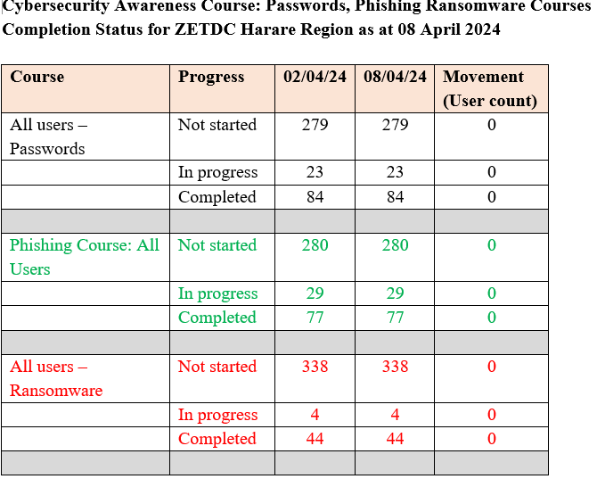

Slide 7
ACTIVITY/PROJECT | 1st Quarter Targets | Actual | Variance | CHALLENGES | MITIGATION MEASURES | 2024 Targets
Systems Currently being implemented (HO) |  |  |  | Funding constraints. Competing projects. Lack of user participation in projects. | Secure funding for all projects. Projects streamlining. Enhance communication and collaboration with users.
CRM | ? | ? | - | Staff turnover | Review IT Org Chart | 100%
SAP Fiori | ? | ? | - | Competing demands. | Collaborate with HO and other regions to boost programming team. | 100%
Video Conferencing Solution | ? | ? | - | Commitment from user departments Changing user requirements Integration challenges with existing systems. | Organisational change management | 100%
Electronic Payment System | ? | ? | - | Commitment from user department. | Organisational change management. | 100%
Commercial Mobile App | ? | ? | - | Hardware for security on internet facing end. Competing projects. | Firewall acquisition | 100%
MDMS | ? | ? | - | Data acquisition. Lack of expertise. | Capture as per request Train staff. | 100%
Biometric Systems | ? | ? | - | Commitment from user department. | Organisational change management. | 100%
Website upgrade | ? | ? | - | Hardware for security on internet facing end. |  | 100%
Statistical Metering | ? | ? | - |  |  | 100%

Slide 8
END THANK YOU
“Technology is nothing. What’s important is that you have faith in people, that they’re basically good and smart — and if you give them tools, they’ll do wonderful things with them. Tools are just tools. They either work, or they don’t work.”
Steve Jobs

